Slide 1
AIRLINE RESERVATION SYSTEM
IIT2015016 – KAUSTUBH RAKESH
IIT2015038 – VIPUL KUMAR
IIT2015040 – TUSHAR MINJ
IIT2015043 – VIKASH KUMAR CHAUDHARY
IIT2015068 – RISHABH

Slide 2
OBJECTIVE
The main objective of this application is to decrease the manual mistakes engaged in the commercial airline booking process and create it practical for the clients to book the routes as when they require such that they can implement this application to create bookings, change bookings or terminate a particular booking.

Slide 3
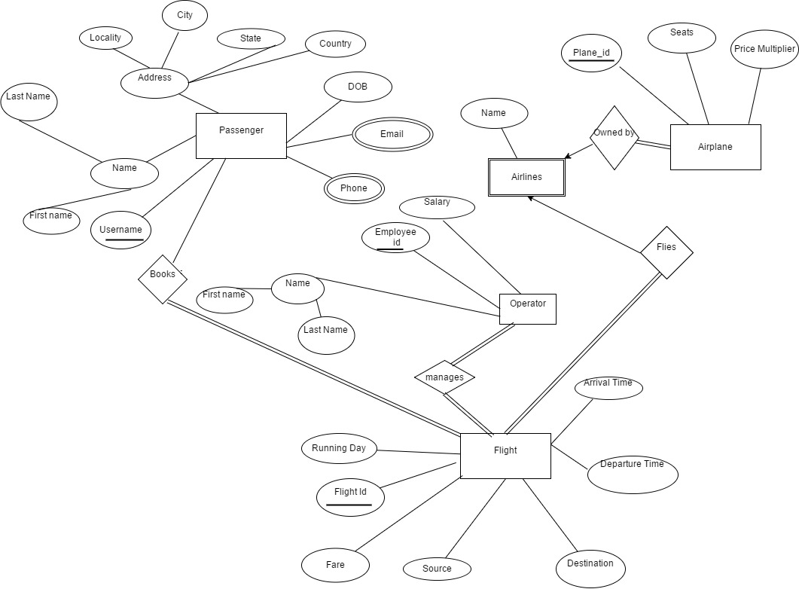
ER DIAGRAM

Slide 4
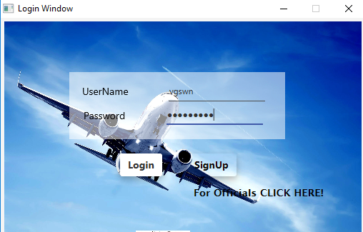
z
Login Window:-
If you are a user, enter your username and password to log in
If you are a new user, sign up!
For officials, go to official login page

Slide 5
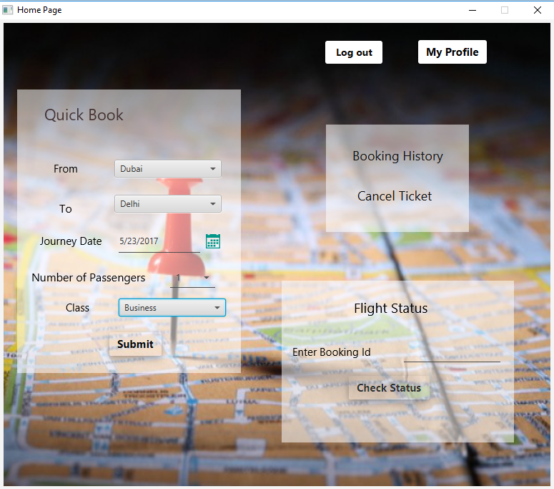
This is homepage of app
Everything happens here
First, lets click on my profile

Slide 6
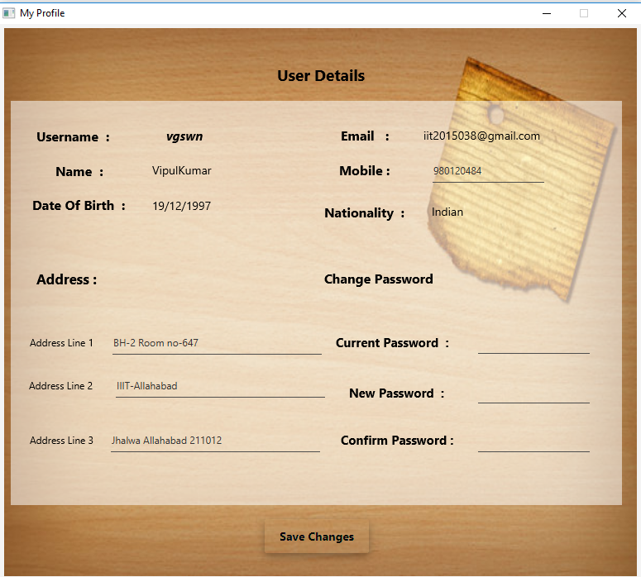
You can view your user details, and modify them if you want
You can also change your password here.

Slide 7
Now, its time for booking history

Slide 8
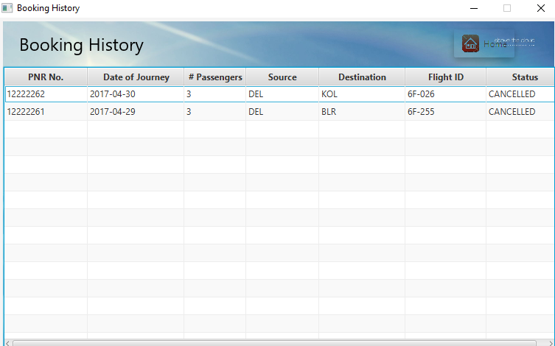
All the tickets that you have booked are stored here
Record of past 3 months is kept

Slide 9
Time to book a ticket !
Enter From, To, pick a date,
Enter no. of passengers and class
And , you’re good to go

Slide 10
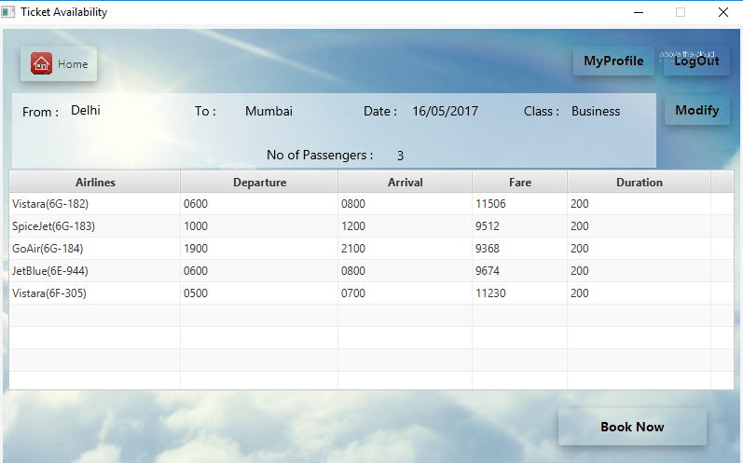
List of all the available flights as per your query is displayed here
Made a mistake while entering details? No problem , you can modify your search… just click on modify.

Slide 11
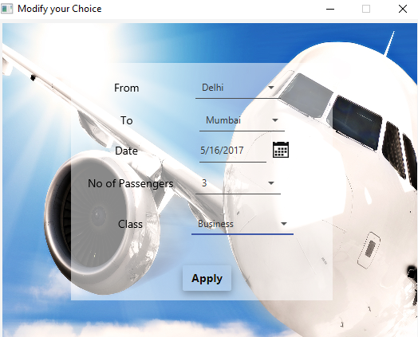
And, this is how it looks, simply edit the field you want to change

Slide 12
Now, select the desired flight,
And click on book now

Slide 13
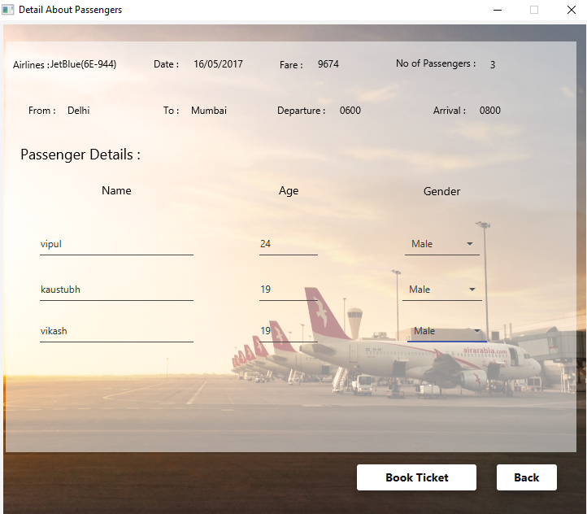
Here, fill out the details of passengers, and finally click on ‘book ticket’ to book a ticket

Slide 14
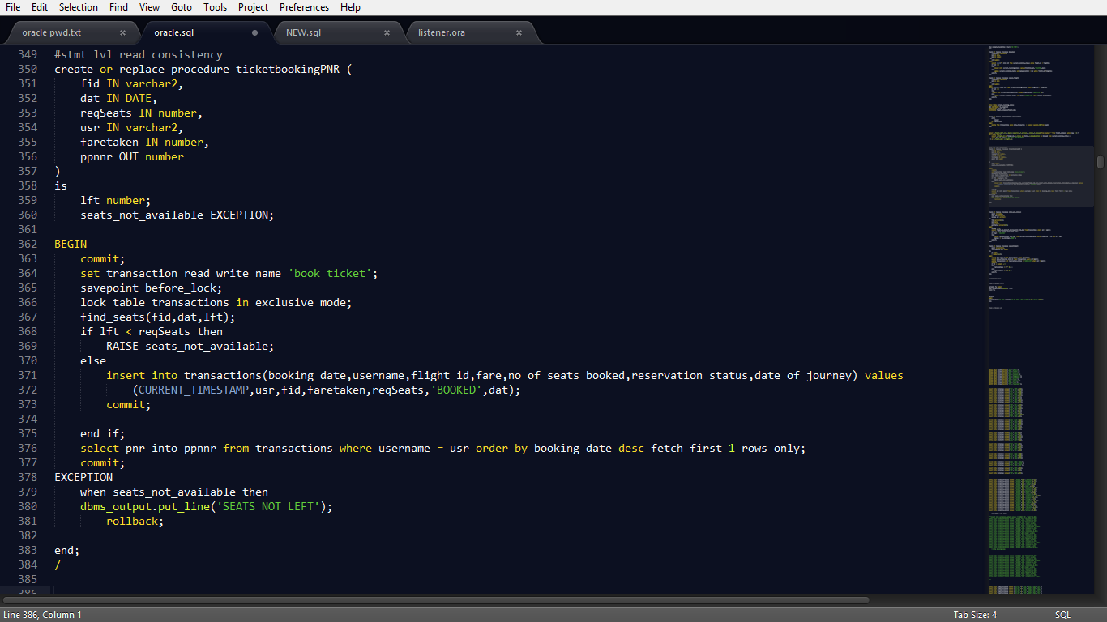
Here’s what happens at backend.. The heart of ticket booking. This procedure ensures that a seat is allotted to only one person, by taking help of powerful concurrency control features of Oracle 12c.
In case there is only 1 seat left, the person who clicks book now earlier gets a seat, other one gets booking failed message.

Slide 15
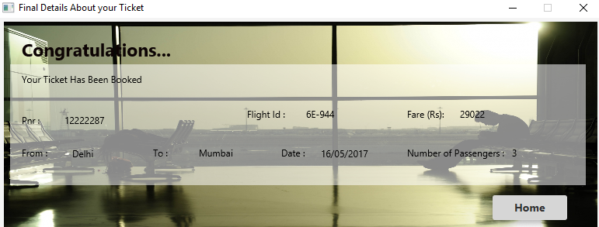
Congratulations…
You just booked a ticket, that’s how your booked ticket looks like !

Slide 16
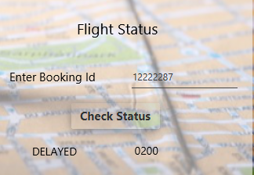
You can also check your flight status, to see if its delayed or on time.
In our case, the flight is delayed by 02 hrs .

Slide 17
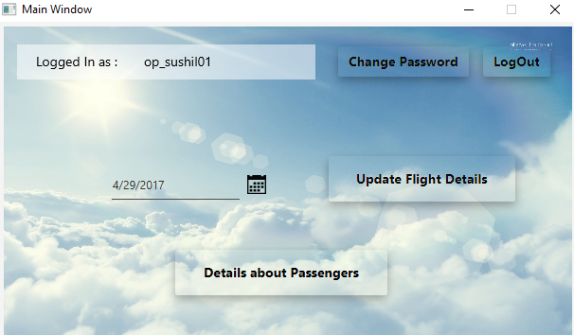
This Is home page for operators
They can see all the flights that are running for a given date, and they can modify them
They can also see all the passengers who have booked a ticket

Slide 18
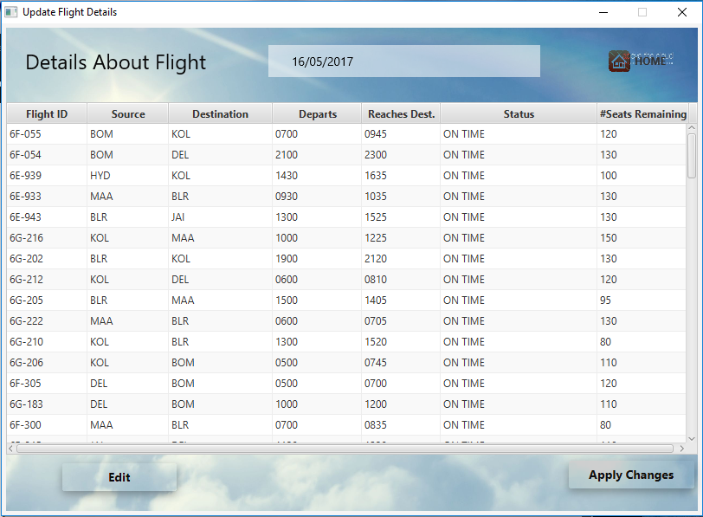
All the details of flights of a particular date are shown.
Suppose , we want to change status of any flight, we can select it, and click on edit.

Slide 19
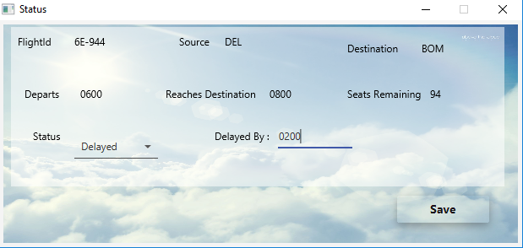
That takes us here,
We can delay or cancel our flight from here
Once a flight is cancelled, the system automatically cancels all the tickets that were booked for that flight, and provides refunds to passengers

Slide 20
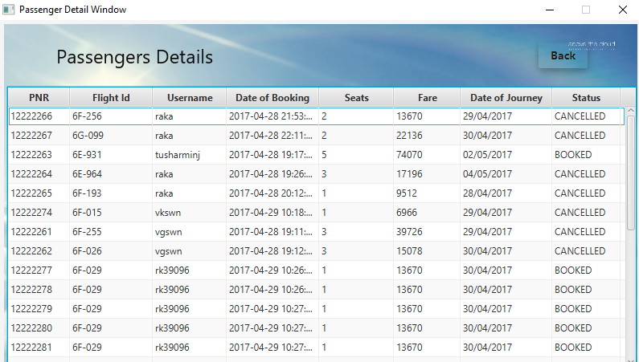
If the operator clicks on passenger details, he is taken to this window, where he can view all the tickets that were booked.

Slide 21
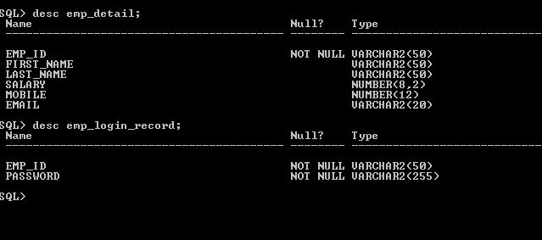
Following is the description of tables that we used in our database :-

Slide 22
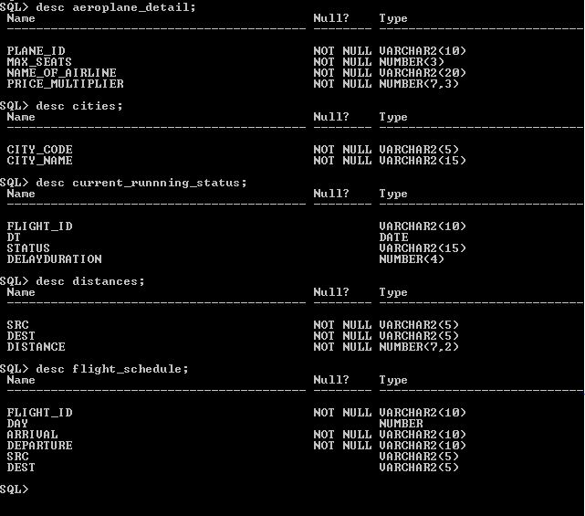

Slide 23
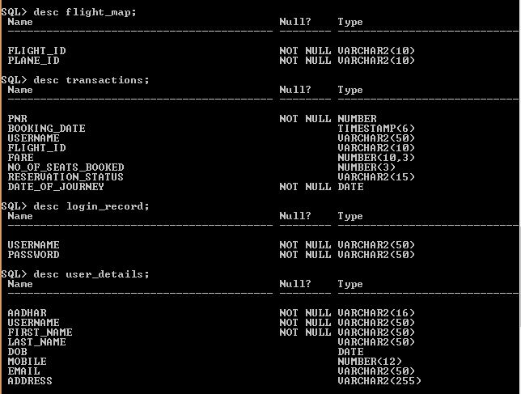

Slide 24
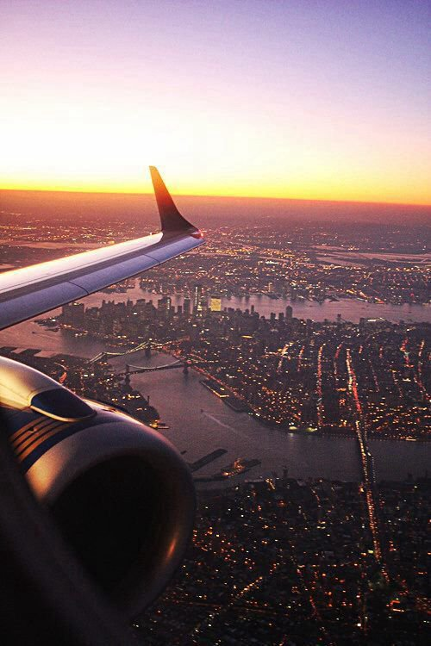
THANK YOU !

